Slide 1



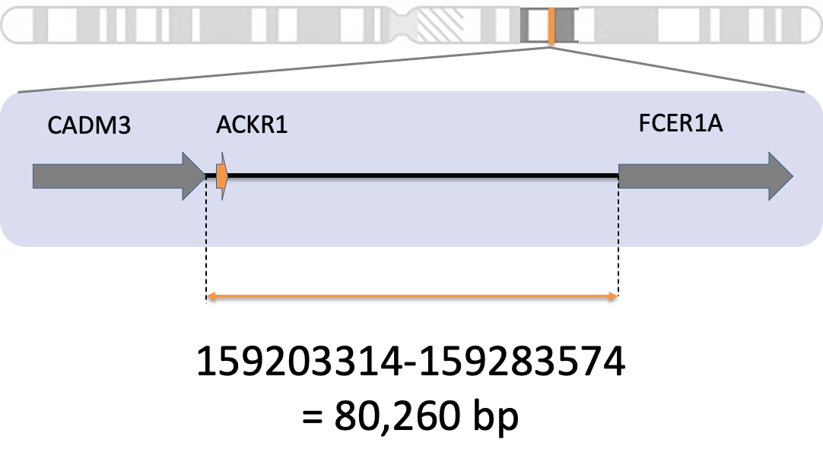
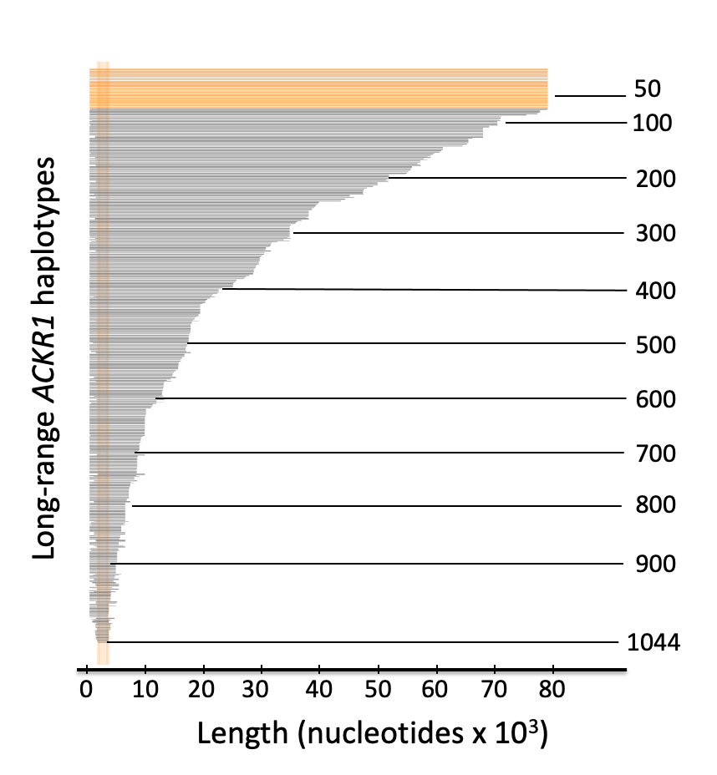
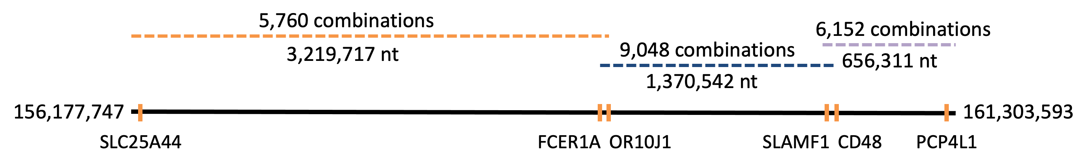
HapPy: an Algorithm for Chromosome-Scale Haplotype Reconstruction using Experimentally Verified Sequences from the 1000 Genomes Project
Anne-Sophie Fratzscher^{1,2}, Kshitij Srivastava¹, Willy A. Flegel¹
¹Department of Transfusion Medicine, NIH Clinical Center, National Institutes of Health, Bethesda, MD
²McGill University, Montréal, QC
Aims
Methods
Conclusions
Identify conserved haplotype sequences across 26 different populations from the 1000 Genomes Project for 100 genes on the long arm of chromosome 1
Construct consensus sequences from overlapping full-length haplotypes of those 100 genes
Figure 1: Diagram of the HapPy Pipeline
Description
HapPy can identify long-range haplotypes for 100 genes on the long arm of chromosome 1 that are not affected by known errors of computerized genotype phasing
These long-range haplotypes can be used as references for genes (e.g. ACKR1) that lack long references
Three consensus sequences were generated spanning the entire region, and these sequences capture genetic differences from different human populations
1. Select genes
Download locations of genes on chromosome 1
Analyze SLC25A44 to PCP4L1 = 100 genes = 156,177,747:161,303,593 = 5,125,846 nt
.
2. Compute long-range haplotypes for genes
Select region between end of previous gene and start of next gene
Haplotypes are regions with complete homozygosity or a single heterozygous SNV
.
3. Combine full-length haplotypes
Extract full-length haplotypes for each gene
If haplotypes have 100% sequence identity in overlapping region, combine
Keep extending consensus sequence until reach the last gene
GRCh38 assembly
select a gene (e.g. ACKR1)
Background
Haplotypes are sets of single nucleotide variations (SNVs) that are inherited together from a parent
Can be used to understand genetics of disease
Also important for blood group matching
Haplotype phasing is the process of inferring haplotypes from genotype data
Mostly done computationally due to cost and time of lab-based methods
Relies on correct reference sequence
Long continuous stretches of homozygosity (LCSHs) are regions that contain at most one heterozygous SNV
Why are they interesting? -> presence of LCSHs in unrelated individuals across different populations is attributed to lower average recombination rate in those regions of the genome
The current human reference genome, Homo sapiens genome assembly GRCh38 (hg38), was released in 2013
Multiple concerns with the current reference genome:
70% from one individual
Does not fully reflect human genetic diversity
Most blood groups lack long reference sequences
The 1000 Genomes Project (1kGP) ran between 2008 and 2015 and sequenced 2504 unrelated individuals in Phase 3 dataset¹
Goal was to create public database of human genetic variation
Improved dataset was released in 2020 -> 2504 individuals from 1kGP Phase 3 + 698 additional samples = 3202 individuals
30x coverage (vs. 7.4X coverage for 1kGP Phase 3) discovers over two-fold more SNV sites
LCSHs were previously extracted from the 1kGP and identified experimentally confirmed reference sequences for the Duffy gene (ACKR1)²
Future Directions
Explore improved heuristics to generate a single consensus sequence spanning the entire region
Expand to the remaining genes on chromosome 1, eventually to all genes to generate a more genetically diverse reference sequence alternative to hg38
Generate reference sequences unique to the five super- populations (African, American, East Asian, European, South Asian)
…..(adding ML)
get results for all genes
1kGP 30x
extract full-length haplotypes
genotype data for gene (3202 individuals)
overlaps
Clinical Implications
combine
Use ACKR1 haplotypes as references to facilitate blood group genotyping between donors and recipients
Exact matching improves survival after bone marrow transplantation and reduces alloimmunization
A more diverse reference genome could aid population-specific studies on genetic predisposition to diseases³
May aid in development of personalized medicine³
consensus sequences
repeat for other genes
Results
Acknowledgements
References
Long-range haplotypes (+ frequency and population information) were generated for 100 genes
At least one full-length haplotype was generated for each gene
Attempting to find all possible combinations led to exponential increase in possibilities
A heuristic was developed to try to solve the problem:
Full-length haplotypes are ranked by frequency
Sum ranks of the current consensus sequences and full-length haplotype when extending
If the number of consensus sequences exceeds 10,000 instances, keep only the top 10,000
Using this heuristic, three consensus sequences were constructed (Figure 2)
Anne-Sophie would like to thank Dr. Willy A. Flegel and Dr. Kshitij Srivastava for their outstanding mentorship and support throughout this project, and for introducing her to research in genomics and bioinformatics, specifically for transfusion medicine.
Anne-Sophie would also like to thank the NIH Summer Internship Program.
¹Auton, A. and Abecasis, G. R., et al. A global reference for human genetic variation. Nature 526, 68–74 (2015).
.
²Srivastava K, Fratzscher AS, Lan B, Flegel WA. Cataloguing experimentally confirmed 80.7 kb-long ACKR1 haplotypes from the 1000 Genomes Project database. BMC Bioinformatics. 2021 May 26; 22(1):273
. ³Hindorff, L, Bonham, V, Brody, L, et al. Prioritizing diversity in human genomics research. Nature Reviews Genetics. 2017 Nov 20; 19(3):175-185
Figure 2: Constructed consensus sequences span the entire region
Notes:
Chromosome 1 figure: https://www.ncbi.nlm.nih.gov/books/NBK22266/
SOURCES: https://www.ncbi.nlm.nih.gov/grc/help/faq/#human-reference-genome-individuals
https://ashpublications.org/blood/article/133/17/1814/275900/Blood-group-genotyping
https://www.internationalgenome.org/announcements/3202-samples-at-high-coverage-from-NYGC/

Slide 2
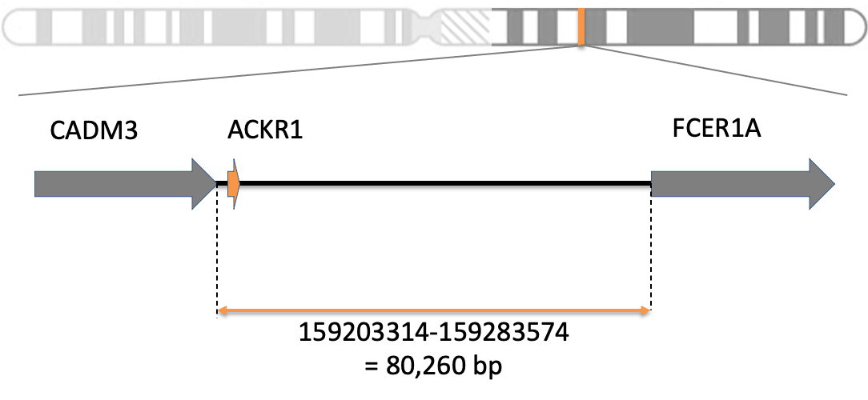
Step 1: Select all protein-coding genes from long arm of chromosome 1
Step 2: Generate haplotypes for genes using long contiguous stretches of homozygosity
extract protein-coding genes on long arm of chromosome 1
select a gene (e.g. ACKR1)
select region between last nucleotide of previous gene and first nucleotide of next gene
Step 3: Build long-range haplotypes from full-length haplotypes for genes
get full-length haplotypes for subset of genes
1000 Genomes 30x on GrCH38
Fetch data
genotype data for gene (3202 individuals)
Extract unambiguous haplotypes by selecting individual sequences with a single site of heterozygosity or complete heterozygosity

Slide 3

CADM3
ACKR1
FCER1A
159203314-159283574
= 80,260 bp

Slide 4

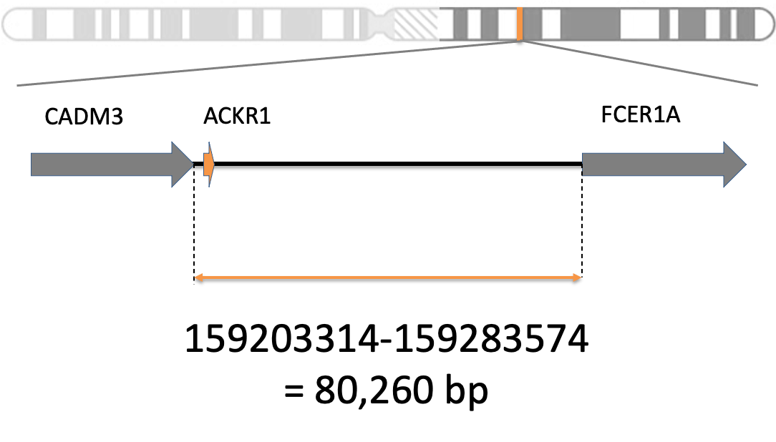
Figure 2: Diagram of the HapPy Pipeline
GRCh38 assembly
select a gene (e.g. ACKR1)
1kGP 30x
get results for all genes
genotype data for gene (3202 individuals)
select full-length haplotypes
long-range haplotypes
repeat for other genes

Slide 5
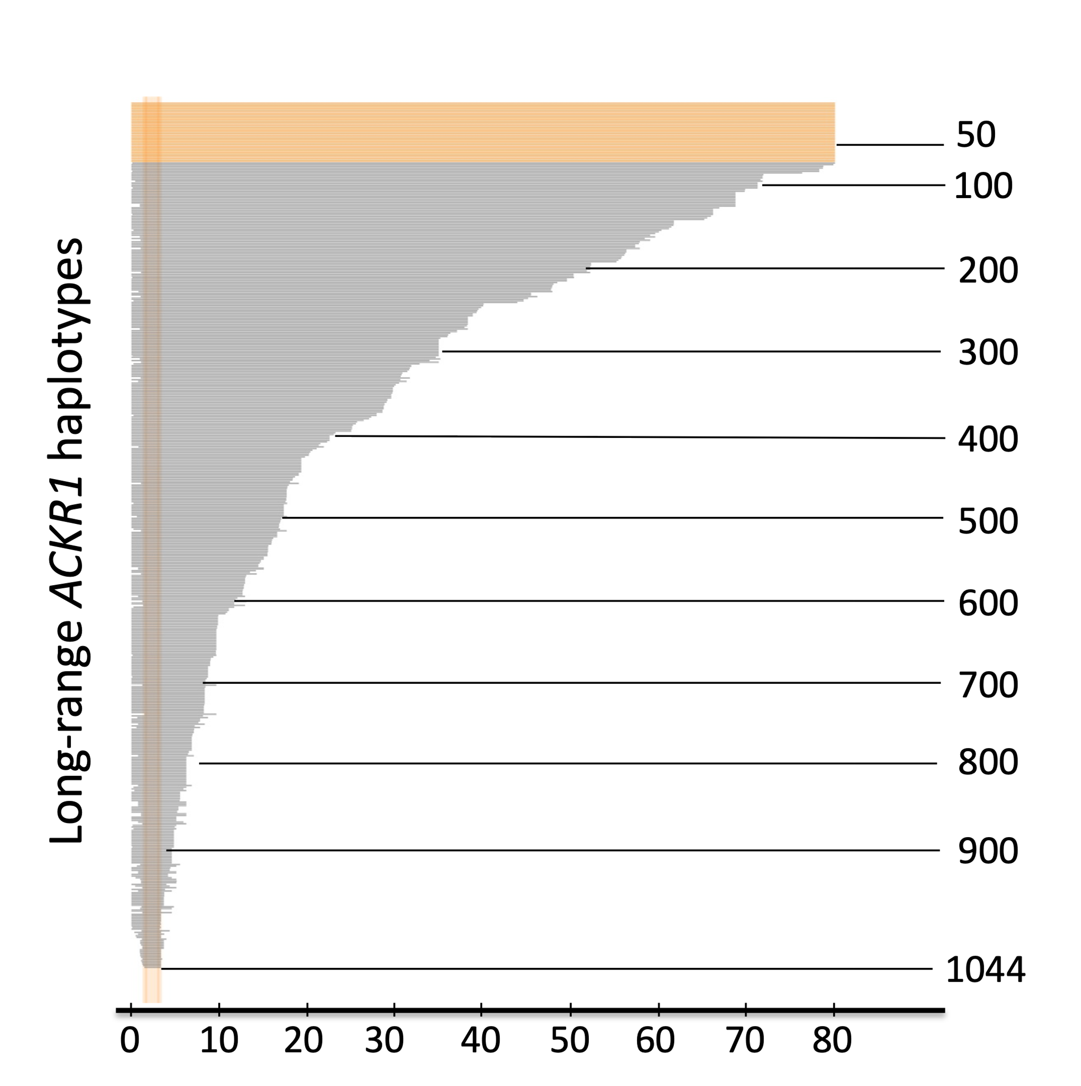
50
100
200
Long-range ACKR1 haplotypes
300
400
500
600
700
800
900
0
10
20
30
40
50
60
70
80
1044
Length (nucleotides x 10³)

Slide 6
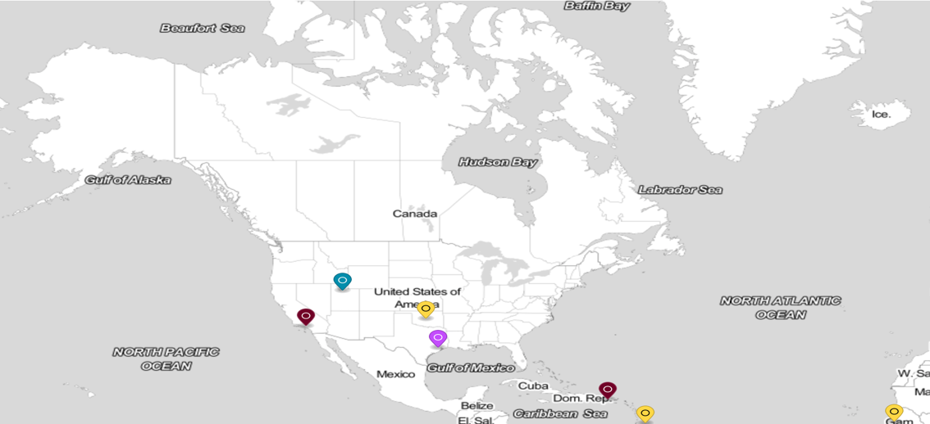
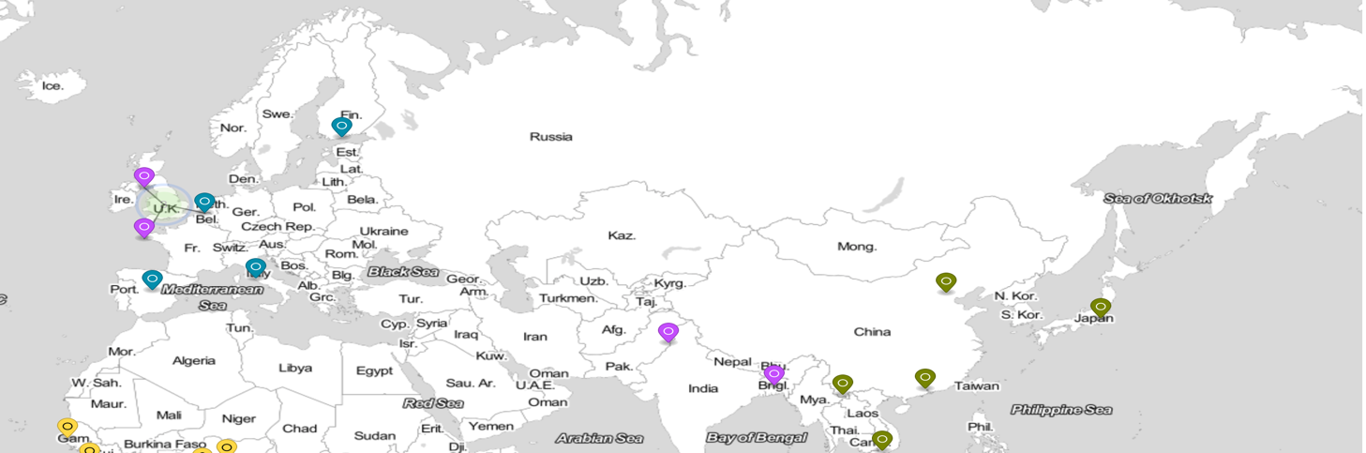
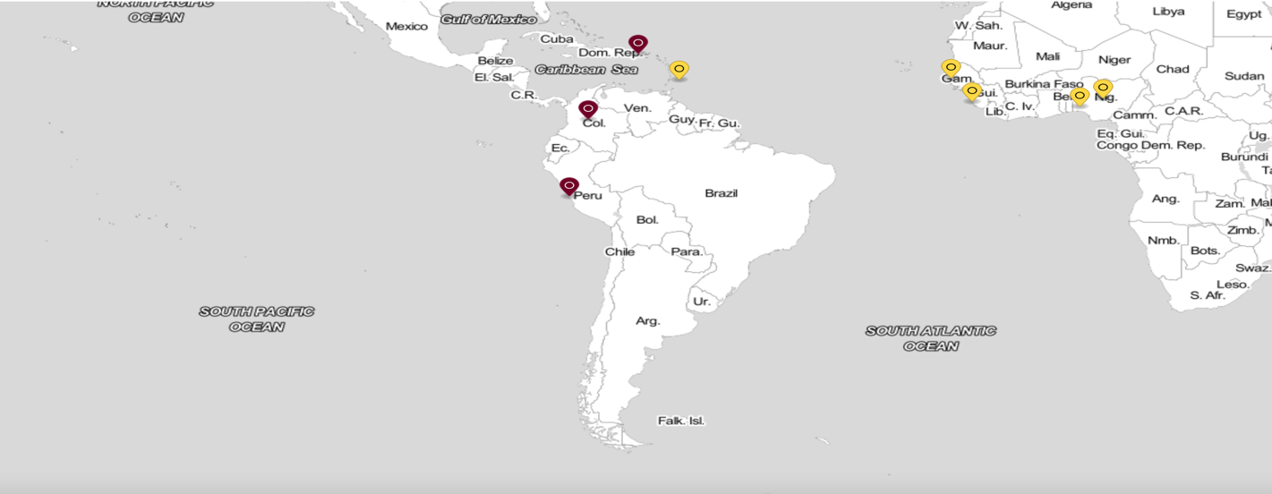
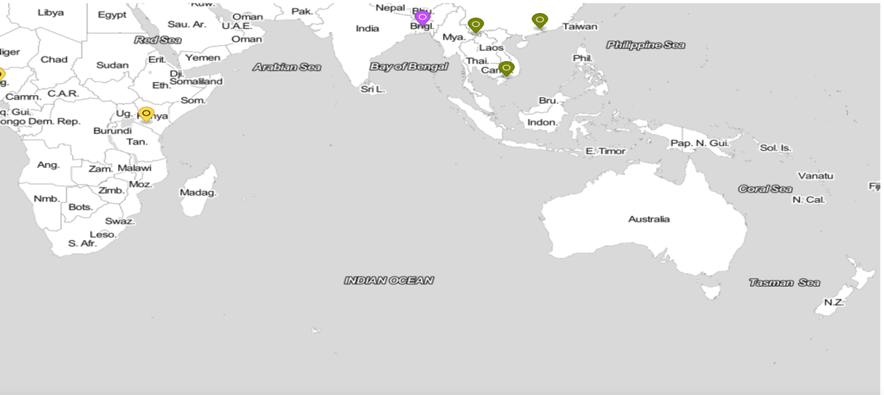
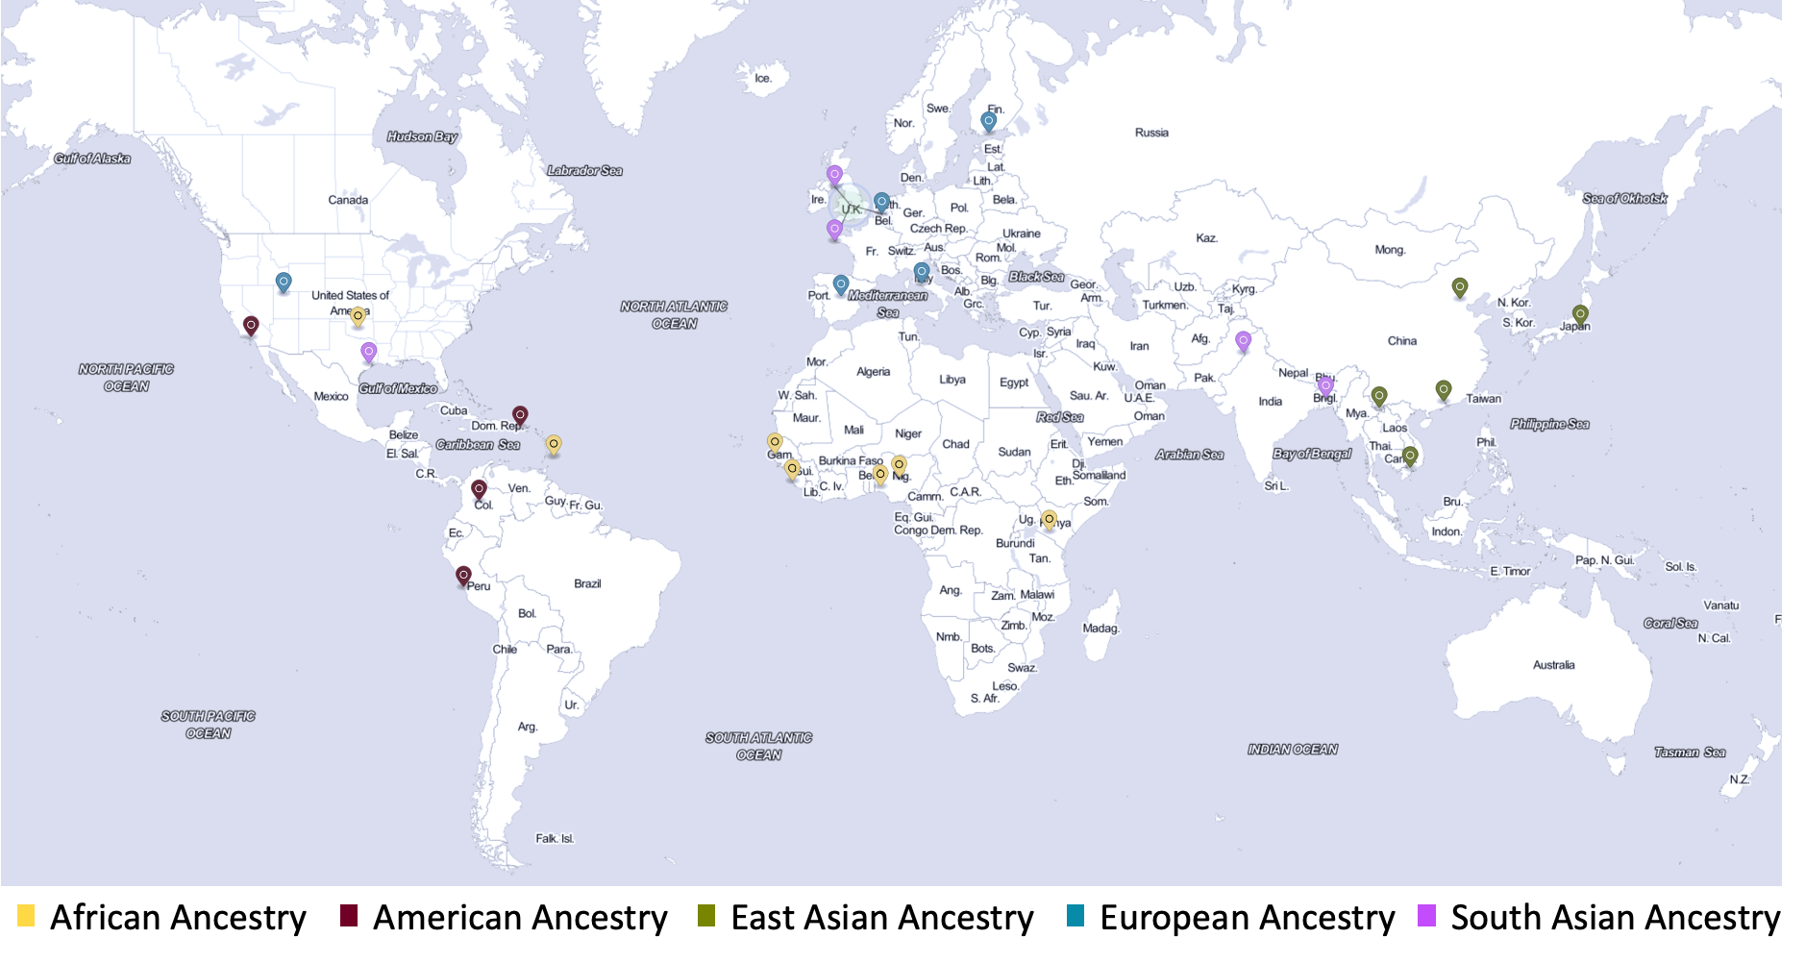
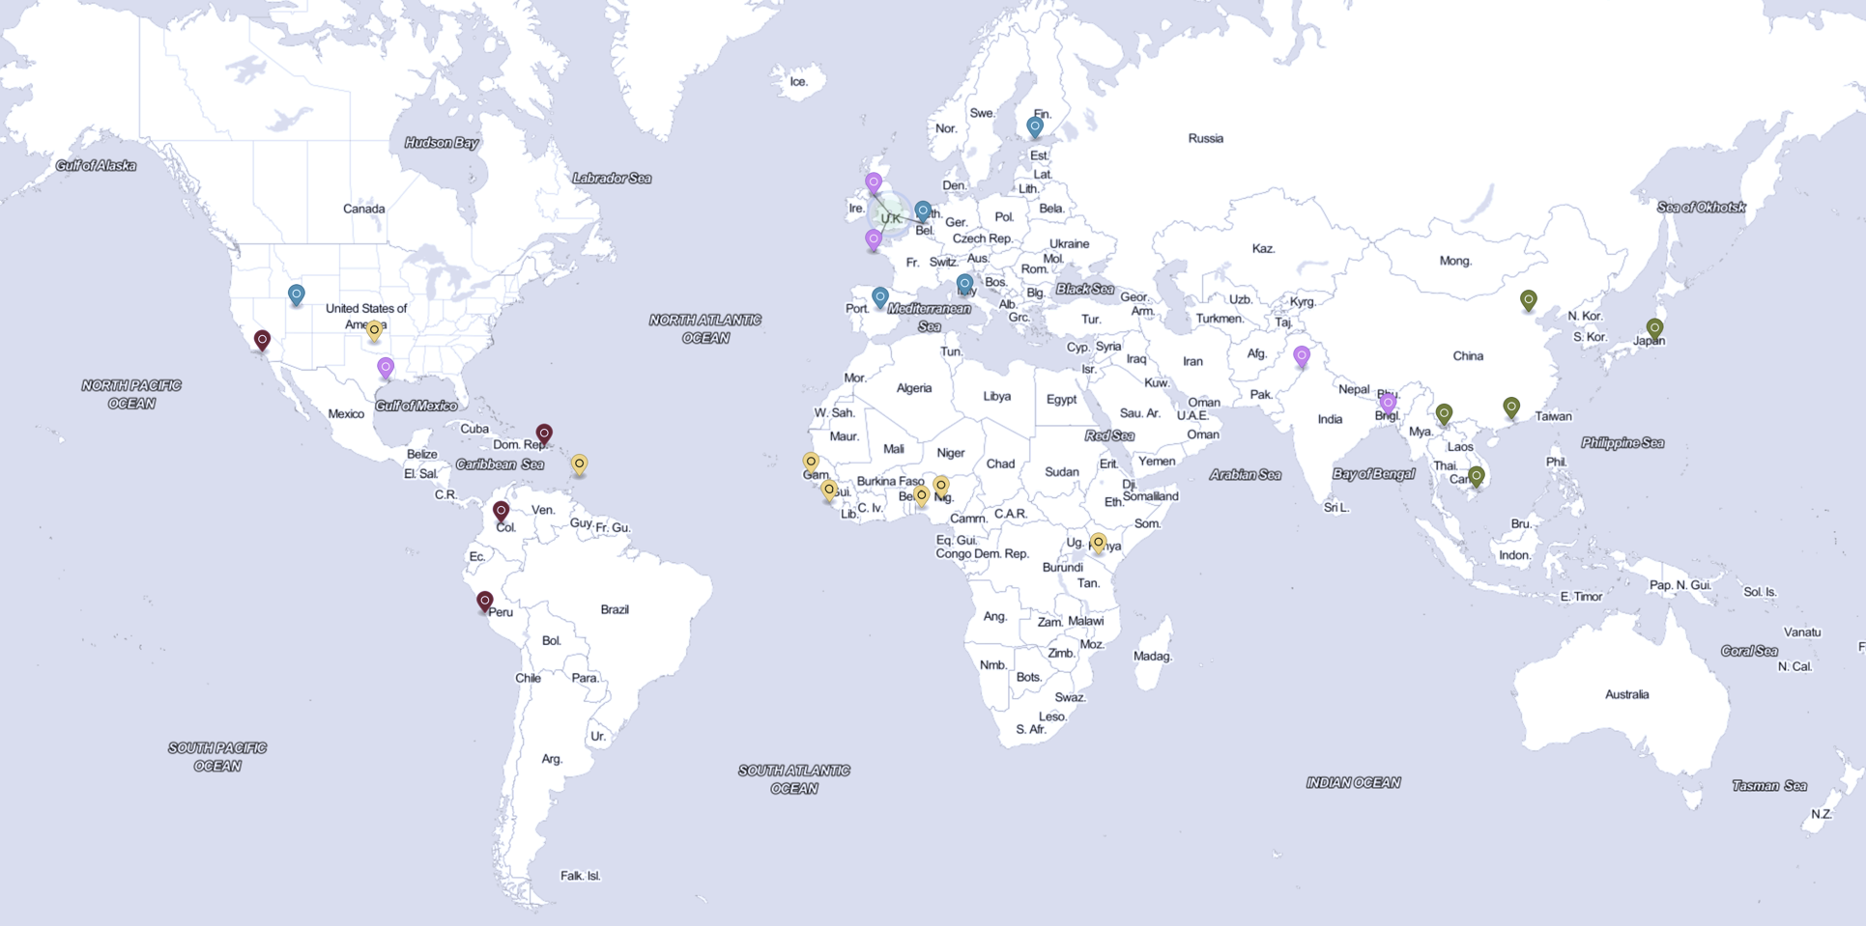
African Ancestry
American Ancestry
East Asian Ancestry
European Ancestry
South Asian Ancestry
Figure 1: Population Distribution for 1kGP 30x

Slide 7
5,760 combinations
9,048 combinations
6,152 combinations
3,219,717 nt
1,370,542 nt
656,311 nt
156,177,747
OR10J1
CD48
161,303,593
SLC25A44
FCER1A
SLAMF1
PCP4L1

